Slide 1

ice2oceans:
a computational framework for Alaska glacier studies
Dr. Anthony Arendt
Senior Research Scientist
APL/eScience Institute, University of Washington

Slide 2
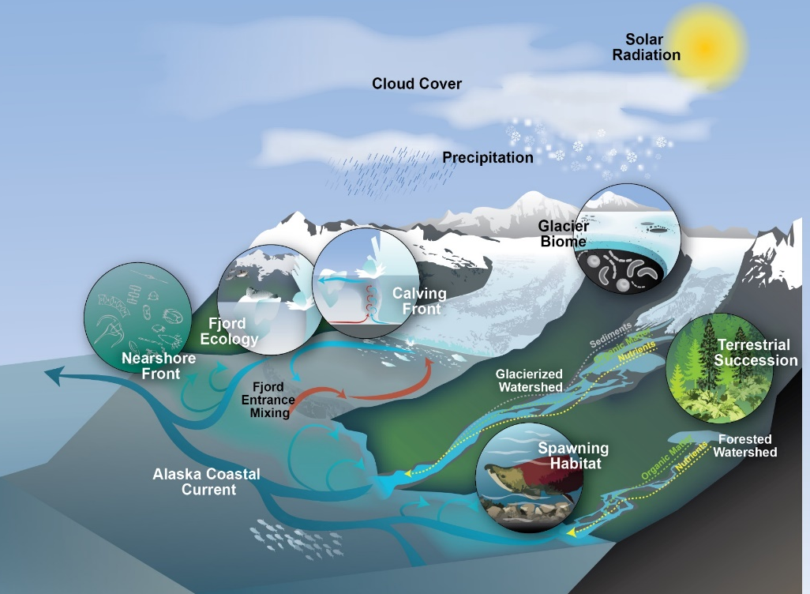
The challenge:
New sensor technologies are producing ever increasing volumes of data with increasing complexity and scope (big data)
Big data opens the door to new integrative science investigations
However, our computational infrastructure has not kept pace - we lack tools to make full use of available datasets.
Alaska case study: the science
Changes in climate are forcing increases in snowpack and glacier runoff
Associated changes in freshwater delivery affect downstream terrestrial and marine ecosystems, and alter global sea levels
Datasets spanning multiple disciplines over a wide range temporal and spatial scales are needed to solve these problems
(Source: Kristin Timm, in O’Neel et al.,2015)

Slide 3
Datasets currently available:
Airborne
Radar (snow water equivalence)
LiDAR (glacier volume change)
Remote Sensing
Gravimetry: regional water mass change
Optical: changes in glacier extent and velocity; elevation distribution
Field
Modeling
weather stations
conventional glacier mass balance
stream gaging
Hydrological (runoff, regional water balance)
Flow: change in glacier geometry
Radar: glacier flow speeds; elevation distribution
Inventory
Glacier extent and hypsometry
Glacier type (tidewater, lake, land)
Climate regions

Slide 4
Datasets by type, volume, complexity
Airborne
Type
Volume: HIGH (100s GB)
Remote Sensing
Type: gridded (array based)
Field
Modeling
Type: point and time series measurements
Volume: LOW (100s MB)
Complexity: HIGH
Type: gridded (array based)
Volume: HIGH (10s TB)
Inventory
Type: vector point, line, polygon
Volume: MEDIUM (10s GB)
Complexity: MEDIUM
raw data: wave travel times
processed data: point measurements
Complexity: MEDIUM
Complexity: LOW
Volume: HIGH (100s TB)
Complexity: MEDIUM

Slide 5



Our Past Data Model
researchers
Stakeholders/public/other research teams
Sharing of flat files over e-mail
Incoming data pipeline
Federal data center
On-site archiving

Slide 6




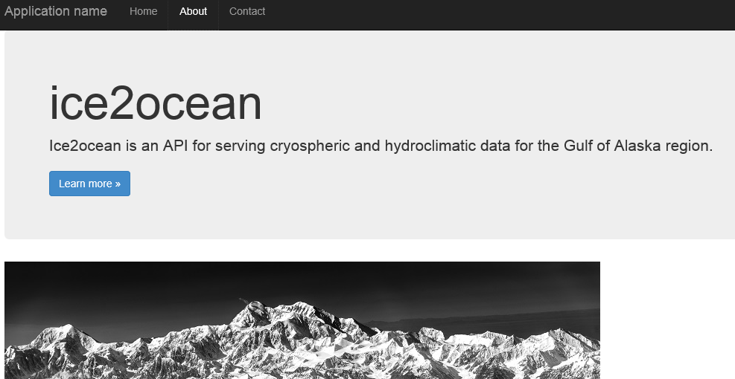

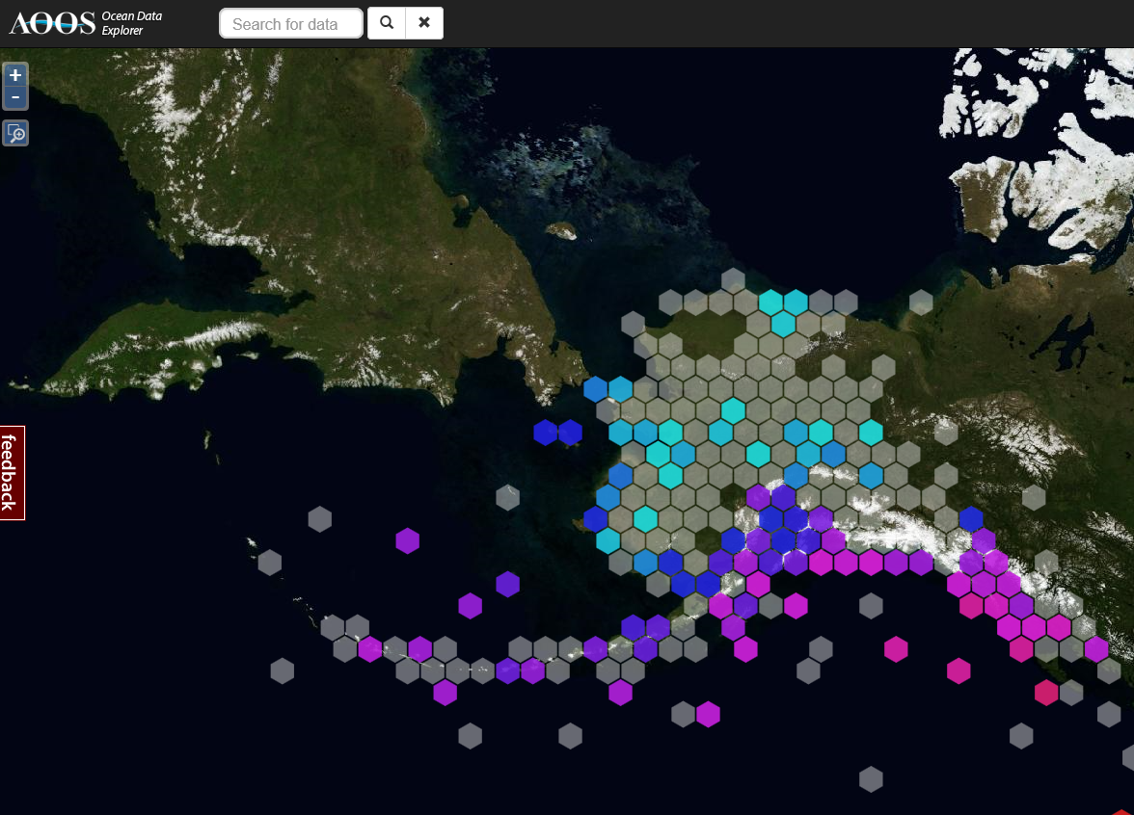
The ice2ocean Data Model
Relational database
Researchers: direct connection via scripts, GIS, software
tabular
Incoming data pipeline
Collaborators: access via web services (API)
Data QC, management, software dev.
gridded
Cloud storage
Stakeholders/public: web sites linked to ice2ocean datasets
Archiving Level 0 data

Slide 7
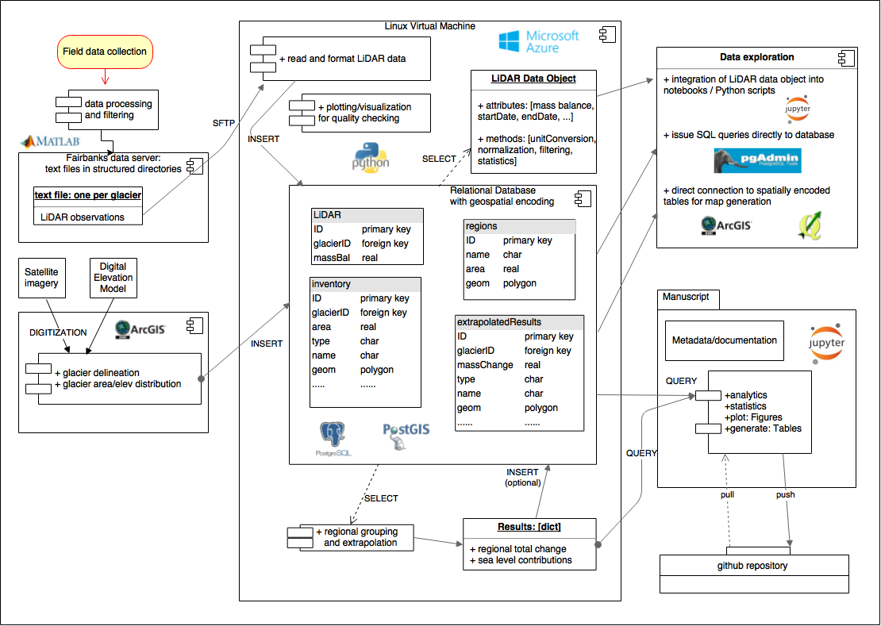

Slide 8
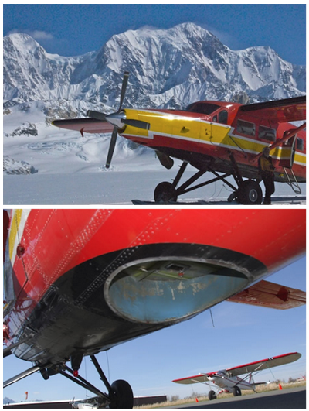
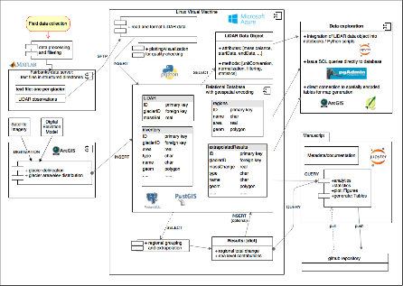
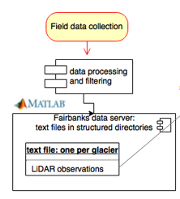
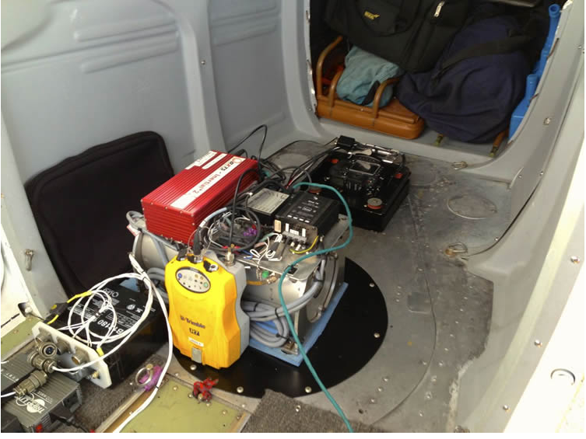
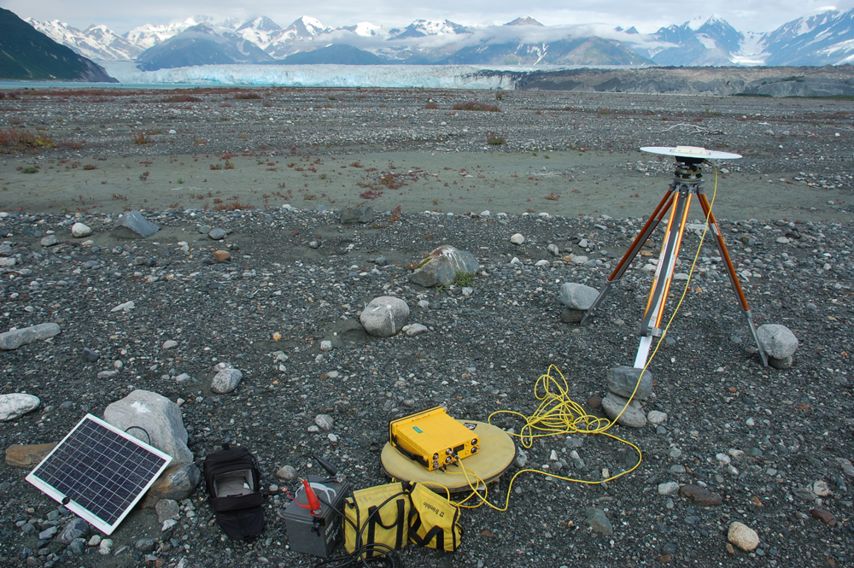
Altimetry System 2007-2015
Notes:
The current laser scanner is a Riegl LMS-Q240i, which has a sampling rate of 10000 Hz. As with the profiler, this scanner has a 905nm wavelength laser.
aircraft elevation of 500m above the glacier surface is 1m x 1m, with a swath width of 500 m. Each laser shot
has a footprint diameter of 20 cm.

Slide 9
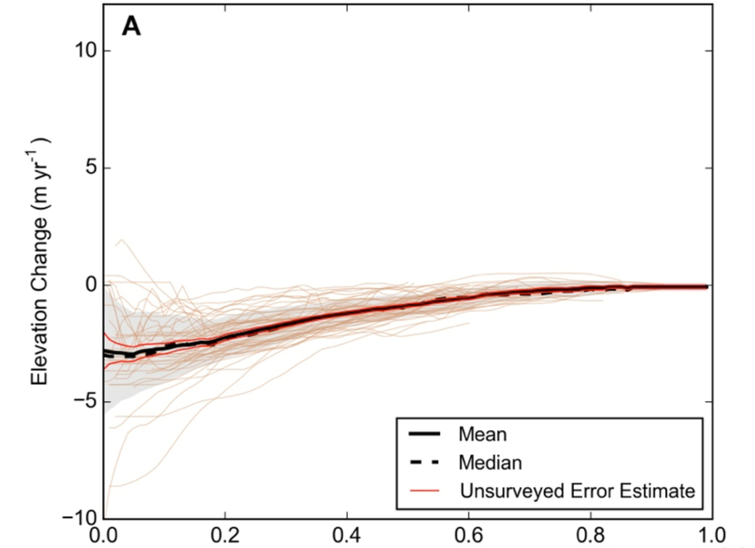
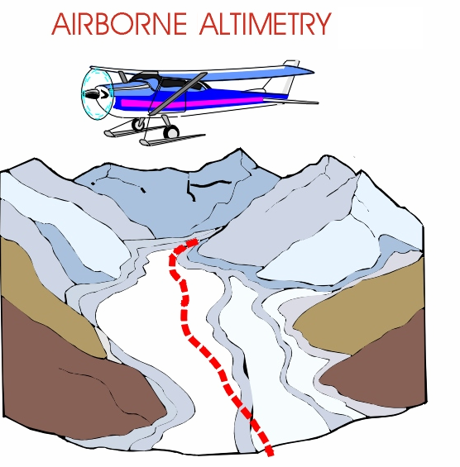
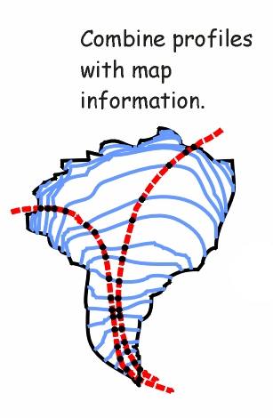
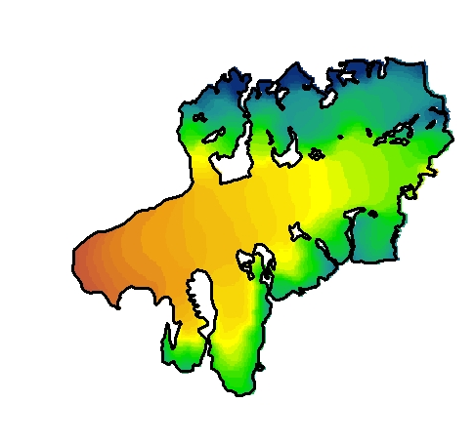
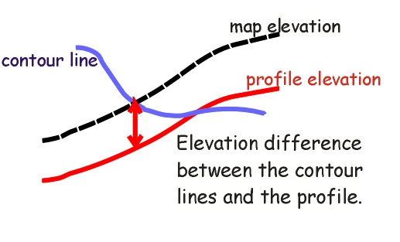
Elevation Changes

Slide 10
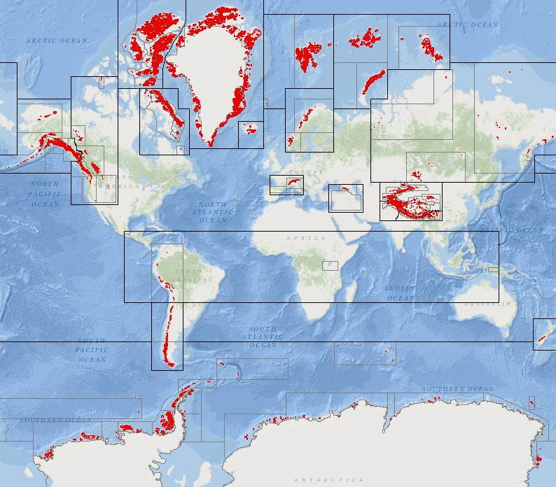
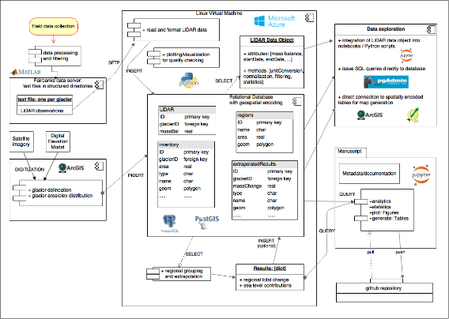
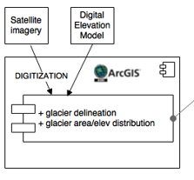
Glacier Inventory

Slide 11
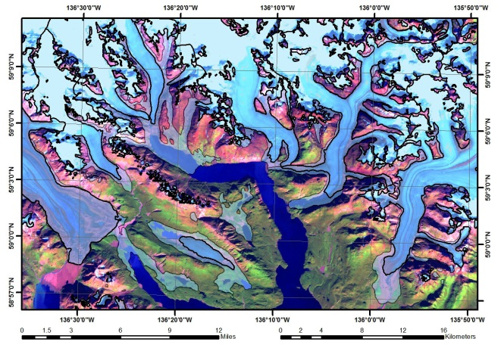
Glacier Inventory

Slide 12
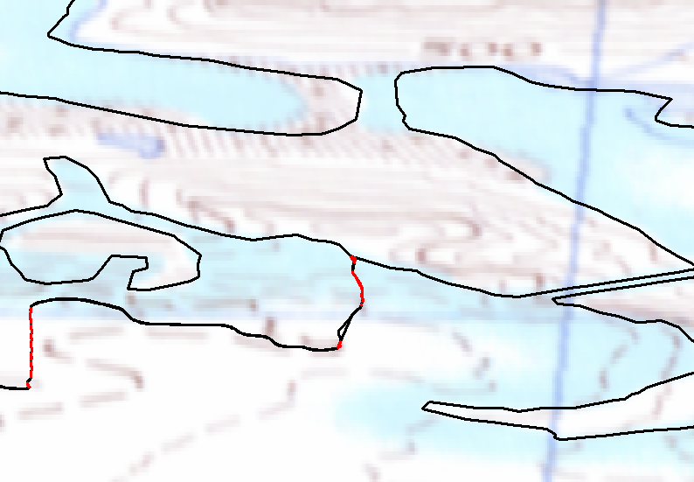
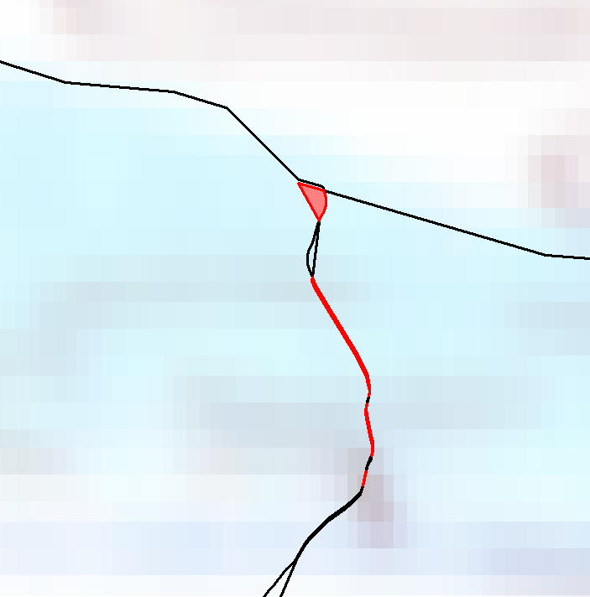
Glacier Inventory: Technical Considerations
outlines were received as ESRI shapefiles
many overlapped with existing outlines
"sliver" polygons were a recurring problem
Notes:
-explain some of the challenges in working with geospatial data from so many different sources
-recommend: set standards for projections,etc.
-how to deal with multiple submissions in one area for the same date, but different quality? Let RC decide?

Slide 13
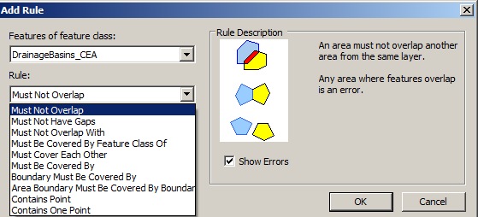
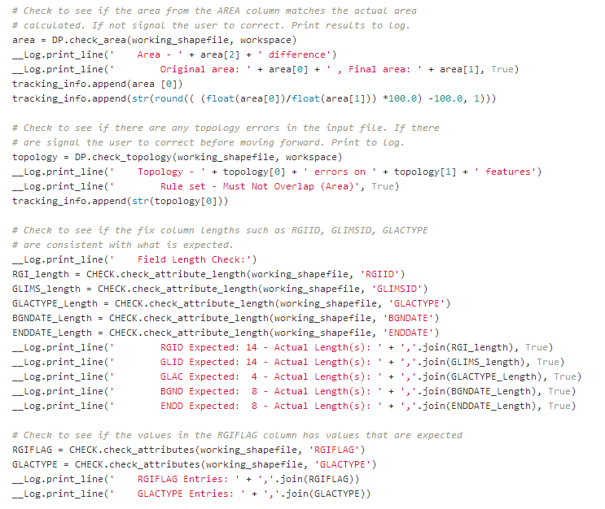
Technical Considerations: Solutions
ArcGIS topology rules
scripts to check for bad geometry
Extensive use of arcpy library
Notes:
This is to emphasize to the current RGI/GLIMS team that a considerable investment has already been made to remedy typical topology and geometry errors. Let's not re-invent the wheel on this in the future.

Slide 14
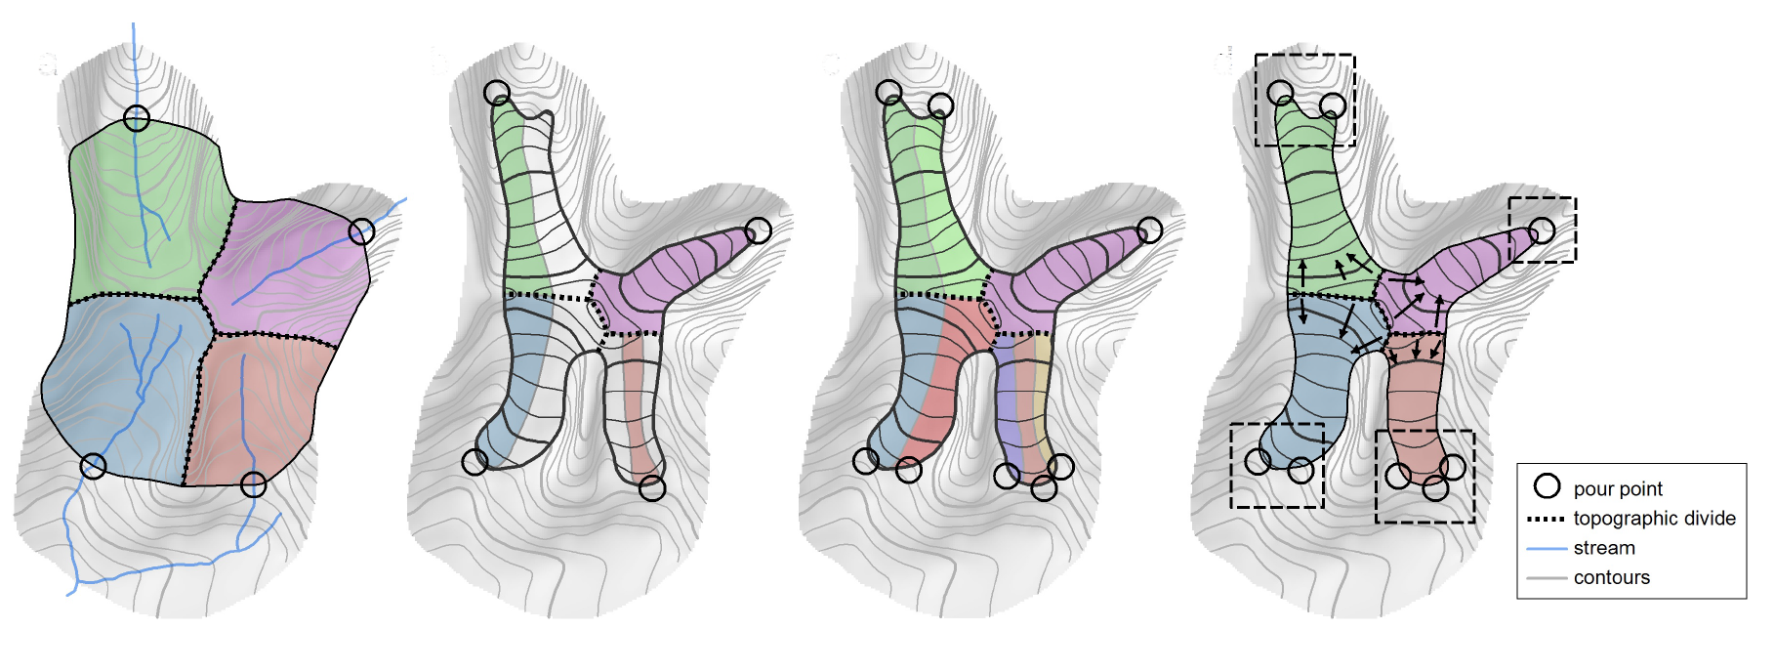
Glacier delineation
Watershed in unglacierized terrain
Drainage basin in glacier terrain (only 1 pour point)
Multiple pour points needed to capture all glaciers
Grouping of pour points by glacier
Kienholz, Hock, Arendt (2013) A new semi-automatic approach for dividing glacier complexes into individual glaciers. J. Glac. Vol 59 (217), 2013

Slide 15
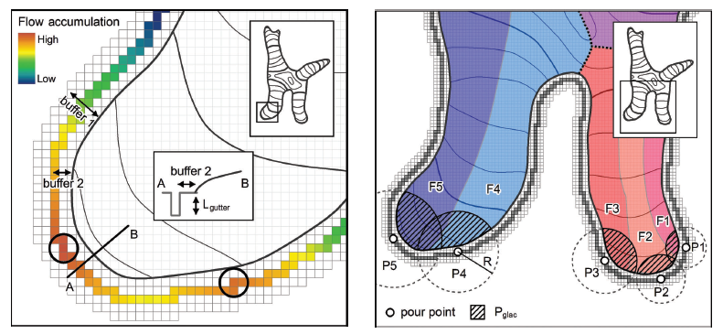
Automatic calculation of pour points

Slide 16
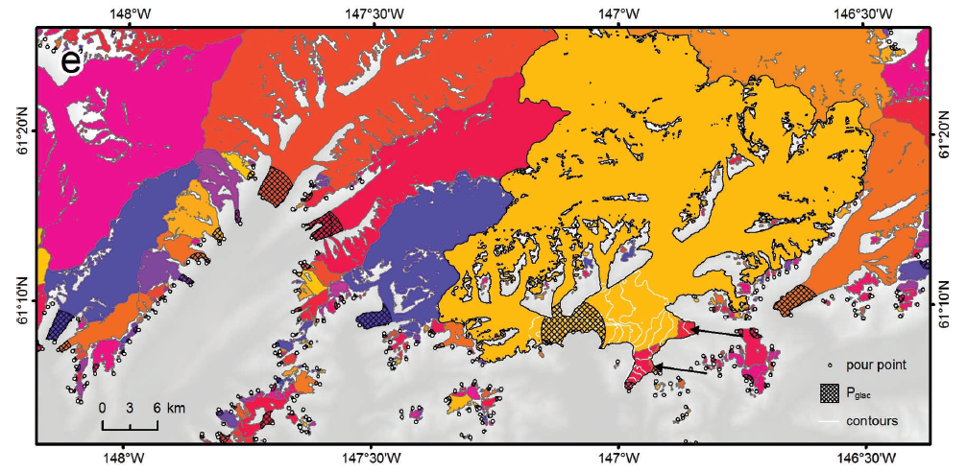
Glacier delineation
Final map of delineated basins

Slide 17
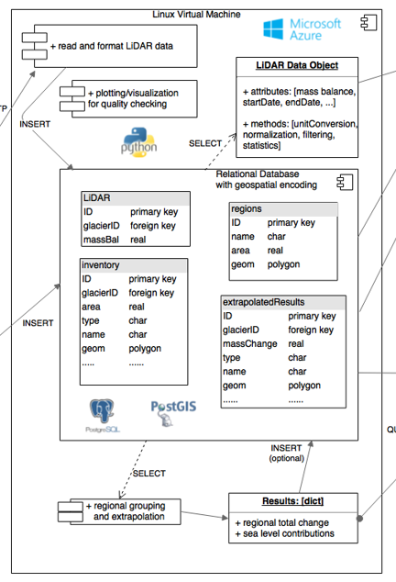
Data Processing

Slide 18
Snapshot of some database tables:
ice2ocean
Database
GRACE
Glacier Inventory
Modern
Hypsometry
Map Date
Hypsometry
Climate grids
Stream Gages
Stream Data
Weather Stations
Weather Data
Additional
LiDAR (10m)
Snow radar
tables have foreign keys (common columns) that enable joining of information
tables that have a location are assigned a “geometry” column that contains geospatial encoding

Slide 20






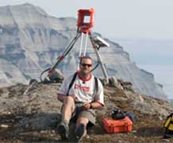


Acknowledgements
Keith
Echelmeyer
Chris
Larsen
Evan
Burgess
Shad
O’Neel

